Slide 1

DEPLOY A CONTAINERISED APPLICATION
By Faisal

Slide 2


Beginning Amazon Web Services
Chapters
AWS API - Refresh
Live Demo – Infrastructure as Code
Live Demo – Containerizing application
Live Demo – Making a REST API call

Slide 3
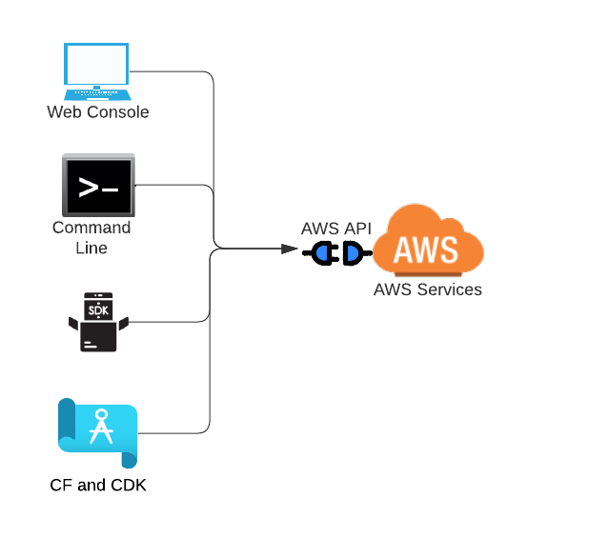

Beginning Amazon Web Services
AWS API
Refresh
Accessing AWS API
Notes:
Amazon EKS works by provisioning (starting) and managing the Kubernetes control plane and worker nodes for you. At a high level, Kubernetes consists of two major components: a cluster of 'worker nodes' running your containers, and the control plane managing when and where containers are started on your cluster while monitoring their status
Runa anywhere from outpost to cloud to your own infra

Slide 4
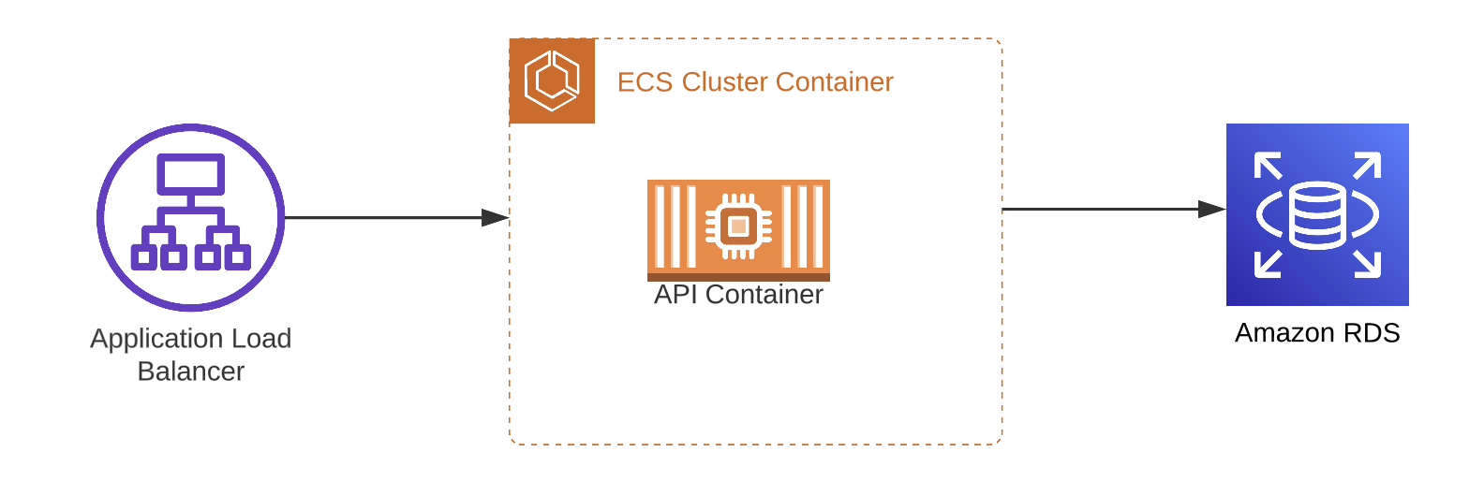
Beginning Amazon Web Services
Demo application
architecture
Notes:
All basic components in the AWS CDK are known as constructs. Each construct defines one or more concrete AWS resources, such as Amazon S3 buckets.
Stack is a set of constructs
App has one ormany stacks

Slide 5

Beginning Amazon Web Services
Summary
Demo application architecture
Course Summary
Notes:
Talk about how easy is to start. Just logni to aws console and start trying…

